Slide 1
16. Ultrasonic Pump
František Kundracik
Department of Experimental Physics
Faculty of Mathematics, Physics and Informatics
Comenius University, Bratislava, Slovakia

Slide 2
16. Ultrasonic Pump
A capillary immersed in an ultrasonic bath works like a pump that can lift water to a considerable height. Explain and investigate this phenomenon.

Slide 3
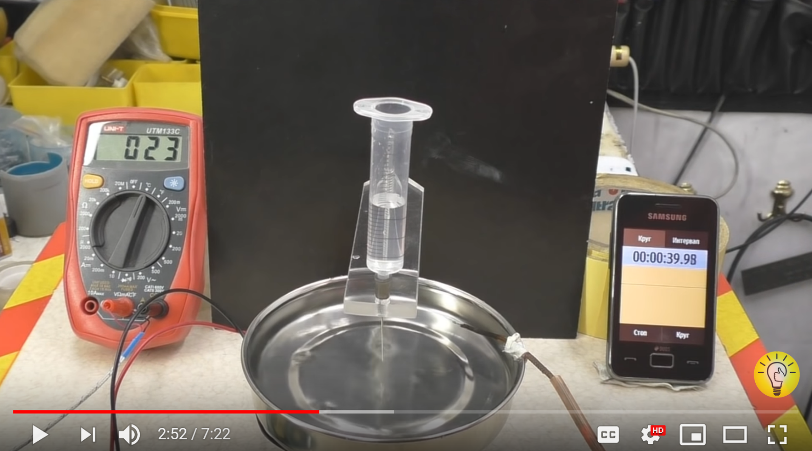
Demonstration of the effect
https://youtu.be/vp2Ez3sgm-Q (1:00 - 4:30)

Slide 4
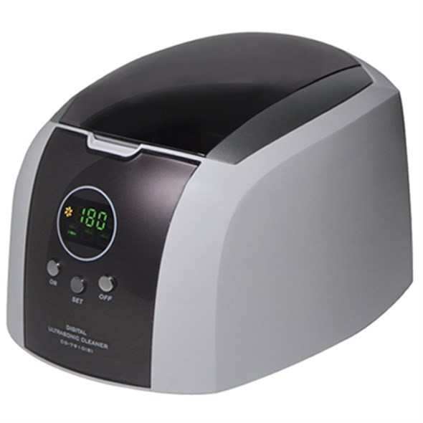
Ultrasound bath
Power of 60W is mentioned in papers as sufficient to observe the effect
Standard jewerly cleaners have the power of 50-60 W, usually without power regulation
Dedicated sources with
precise control of the power
are the best

Slide 5
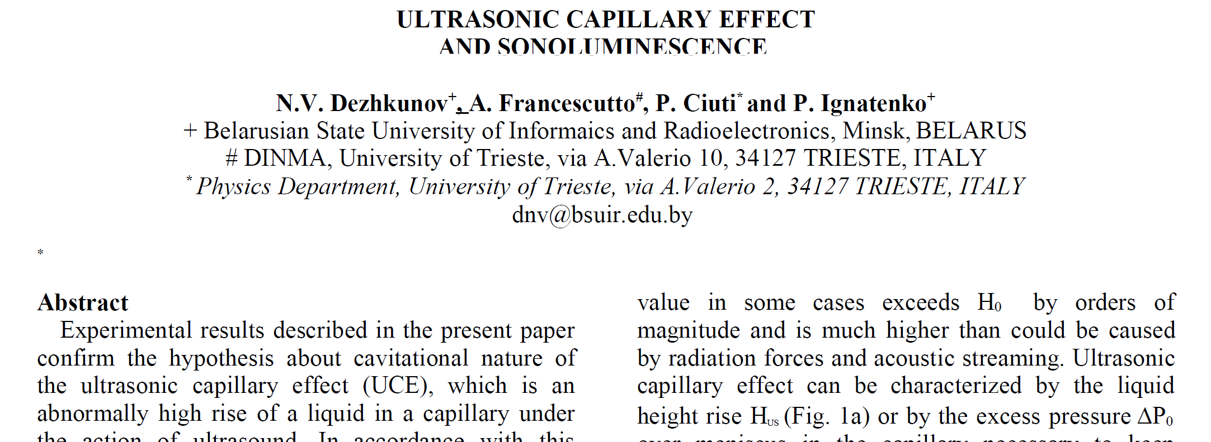
How it works?
No detailed explanation in scientific papers
Experimental evidence that cavitation plays the role (sonoluminiscence, ...)

Slide 6
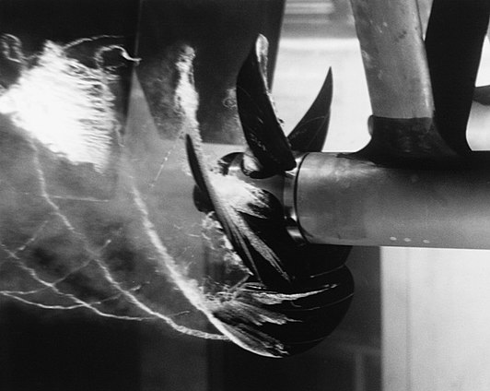
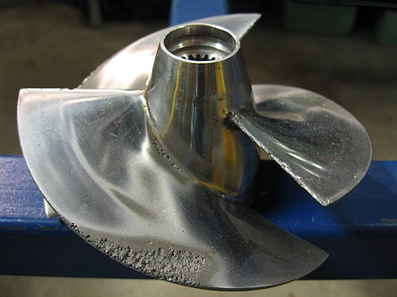
Cavitation
Water has very low compresibility
If the pressure goes rapidly down, unstable bubbles filled with water wapour are formed
If the presure is returned do normal value, bubbles are collapsing and water hits strongly the surface of metal – errosion

Slide 7
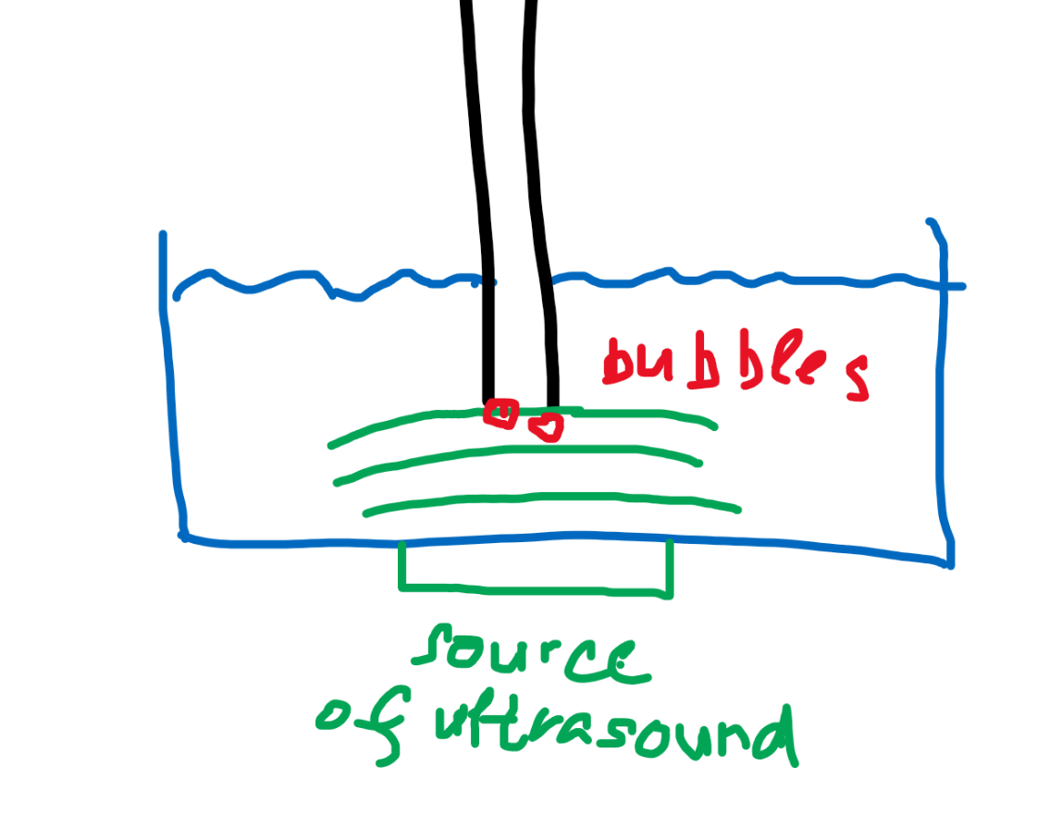
What happens in the ultrasound bath
Simple qualitative explanation
Periodical change in pressure due to ultrasound waves
Mean value of the change in the pressure is zero in compressible liquids – no special effect
Some non-linearity must be involved to observe additional capillarity
Cavitation:
  Compression – high pressure
  Decompression – negative pressure
  is limited by the water wapour
  pressure
  Mean value of the pressure change
  is positive

Slide 8
What to do?
Build your experimental setup, measure the pressure by the height of the water or by electronic pressure-meter, like https://techfun.sk/produkt/senzor-tlaku-mpxv7002dp/
If you have power regulated source:
  Measure the dependence of the height of the water in the capillary on the power: can be observed any critical power needed?
Pressure of the water wapour strongly depends on the temperature (search in the literature) – measure the dependence of the effect on the temperature of water
Is the material of the capillary important? Try metal, glass, hard/soft plastic, ...
Is the diameter of the capillary important? Try various diameters.
Try to formulate a phenomenological model

Slide 9
Literature
http://www.conforg.fr/wcu2003/procs/cd1/articles/000485.pdf
https://iypt.ru/wp-content/uploads/2020/08/An-Ultrasonic-Suction-Pump-with-No-Physically-Moving-Parts.pdf
http://citeseerx.ist.psu.edu/viewdoc/download?doi=10.1.1.823.5232&rep=rep1&type=pdf
Thanks for your attention

